Slide 1
SIGN LANGUAGE DETECTION
Project By :
Mina Nikam.
Vrushali Salvi

Slide 2
PROBLEM
In our society we have people with disabilities.
The technology is developing day by day but no significant developments are undertaken for the betterment of these people.
About nine billion people in the world are deaf and dumb
Communications between deaf-mute and a normal person have always been a challenging task.

Slide 3
SOLUTION
• Hand gesture recognition system is widely used technology for helping the deaf and dumb people.
• Human hand has remained a popular choice to convey information in situations where other forms like speech cannot be used.
• We aim for developing an deaf and dumb gesture recognize system for establishing communication between the deaf and the dumb people.
• Gestures are considered as the most natural expressive way for communications between human and computers in virtual system.
• Hand gestures which can represent ideas using unique shapes and finger orientation have a scope for human machine interaction.

Slide 4
MARKET OVERVIEW
• Deaf and dumb gesture recognition system is an inexpensive device.
• It is also very efficient device when compared to the existing devices.
• The main objective of this project is to achieve communication of deaf-mute people like a normal person.
• It does not require any additional controller or processor.

Slide 5
TARGET CUSTOMER
• It allows deaf and dumb people to communicate with normal people.
• It is a best device for these people to overcome their disability .
• It can also be used to train teachers .
• This hand gesture recognition system can be used for interfacing between computer and human using hand gesture.

Slide 6
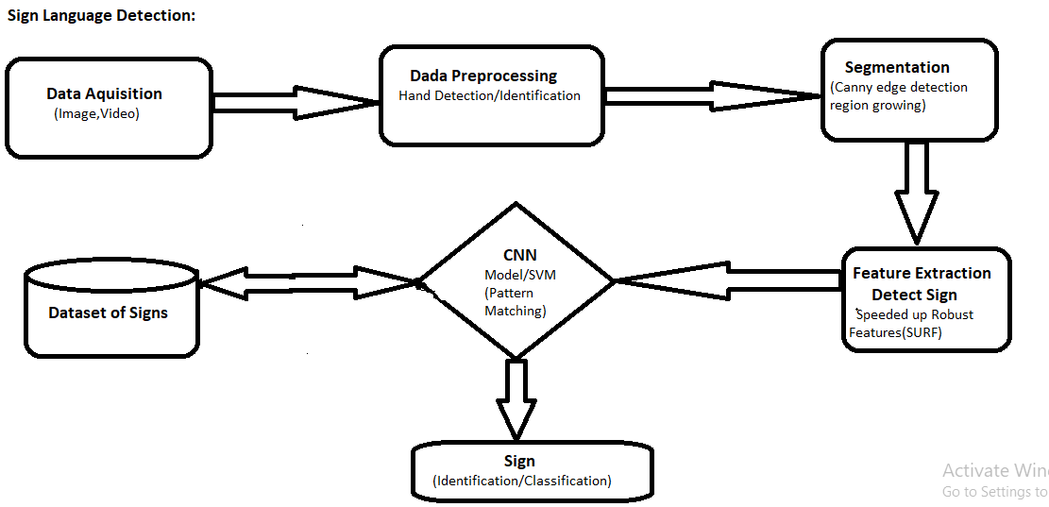
FUNCTIONAL FLOW CHART

Slide 7
FUTURE PLANS
• This systemcan be developed into a device that includes various sign languages in different countries.
• We want to make it into a complete product that makes the deaf and dumb people to communicate like a normal people.
• We want to produce a product for blind people that converts the information in any hand written notes, newspaper or books into a audio signal that these people can here.

